Slide 1




Spring Cloud Config Server

Slide 2

Existing Challenges
Changes to services or environment variables require rebuild and redeploy.

Slide 3
Solution
Spring Cloud Config Server
Centralized, versioned configuration management for distributed applications

Slide 4


Environment Repository
Environment repository used by Spring Cloud Config has two implementations:
Git
spring.cloud.config.server.git.uri=file://D:/IntelliJProject/Git/springCloudConfigserver/git-localconfig-repo
Native (Local files)
spring.cloud.config.server.native.searchLocations=classpath:/

Slide 5
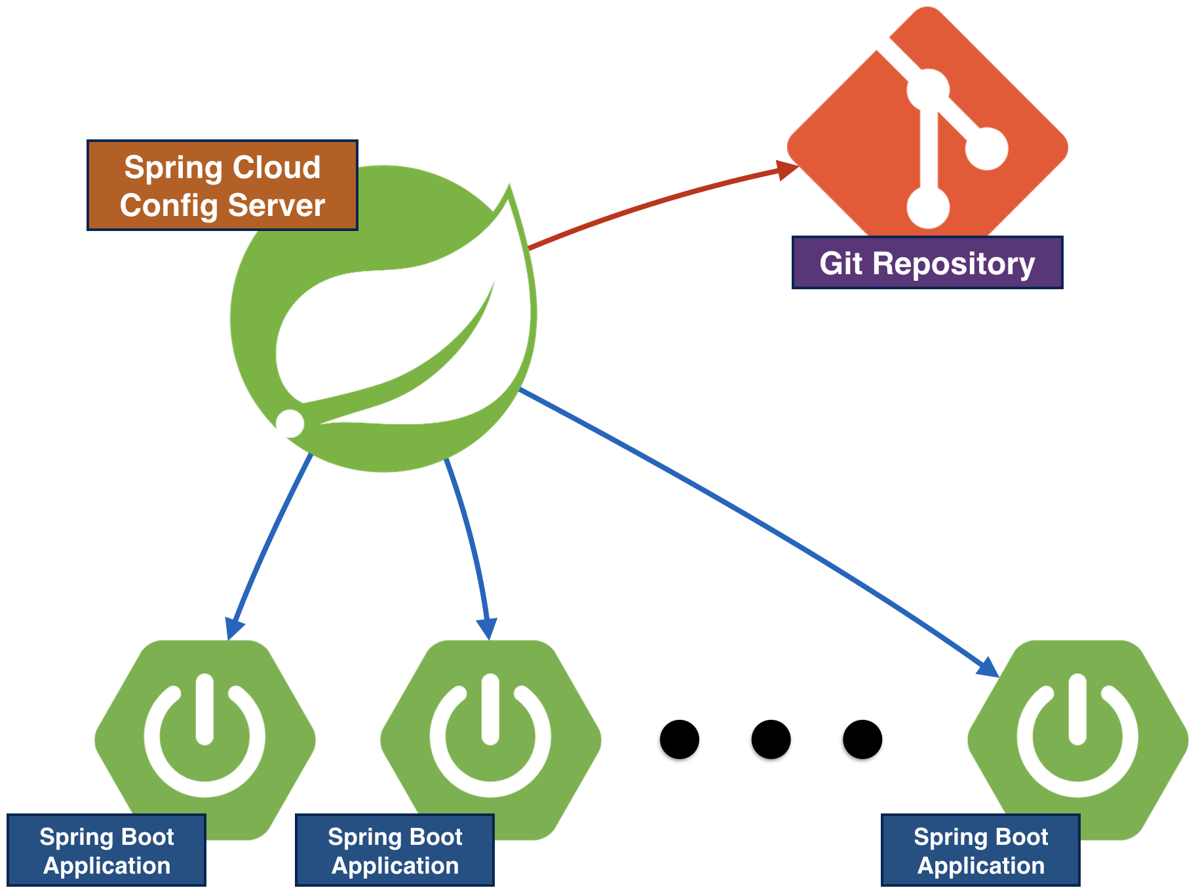

Slide 6
Organizing Environment Repository
Configuration file naming convention:
<spring.application.name>-<profile>.yml
(or .properties)
.yml takes precedence
spring.application.name set by client’s application
bootstrap.yml (or .properties)
Profile: client's spring.profiles.active
Obtain settings from server
http://<server>:<port>/<spring.application.name>/<profile>

Slide 7
Environment Repository Example
Assume client application named “hello-world” and profile set to “dev”
Spring client automatically requests
hello-world-dev.yml - First precedence
hello-world-dev.properties - Second precedence
hello-world.yml - Third precedence
hello-world.properties - Fourth precedence
hello-world-default.yml - Different profile
hello-world-test.properties - Different profile
hi-world.properties - Different app

Slide 8
.yml vs .properties
Settings can be stored in either YAML or standard Java properties file.
Config Server will favor .yml over .properties
.properties file
spring.config.name=aaa
spring.config.location=bbb
spring.profiles.active=ccc
spring.profiles.include=ddd
.yml file
spring:
config:
name: aaa
location: bbb
profiles:
active: ccc
include: ddd

Slide 9

Profiles
YAML format can hold multiple profiles in a single file
hello-world-dev.properties
hello-world=Welcome DEV
hello-world.yml
spring:
profiles: dev
hello-world: Welcome DEV
spring:
profles: test
hello-world: Welcome TEST
hello-world-test.properties
hello-world=Welcome TEST

Slide 10

Pattern Matching & Multiple RePoSITORies
The pattern format is a comma-separated list of {application}/{profile} names with wildcards
If {application}/{profile} does not match any of the patterns, it will use the default uri

Slide 11

Refresh
Client application can have this property to enable refresh end point
management.endpoints.web.exposure.include=*
User has to trigger the refresh end point by hitting this url
http://localhost:8080/actuator/refresh

Slide 12
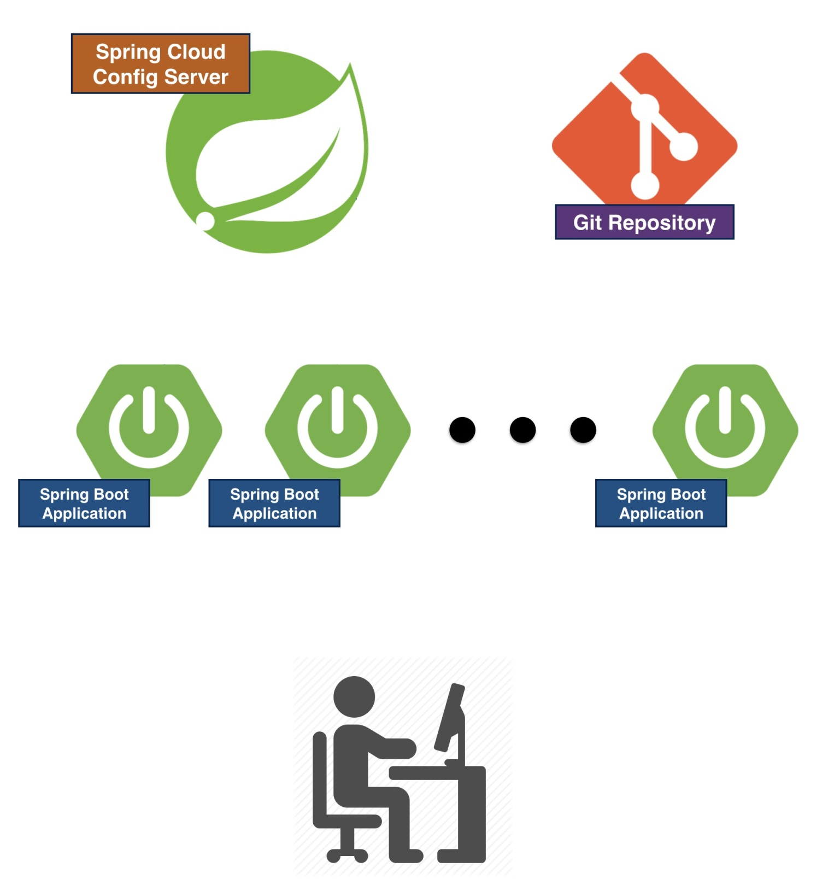
Refresh
Refresh
Refresh
Refresh

Slide 13

Spring Cloud Bus
Spring Cloud Bus links nodes of a distributed system with a lightweight message broker
User has to trigger the bus end point by hitting this url
http://localhost:8080/bus/refresh

Slide 14
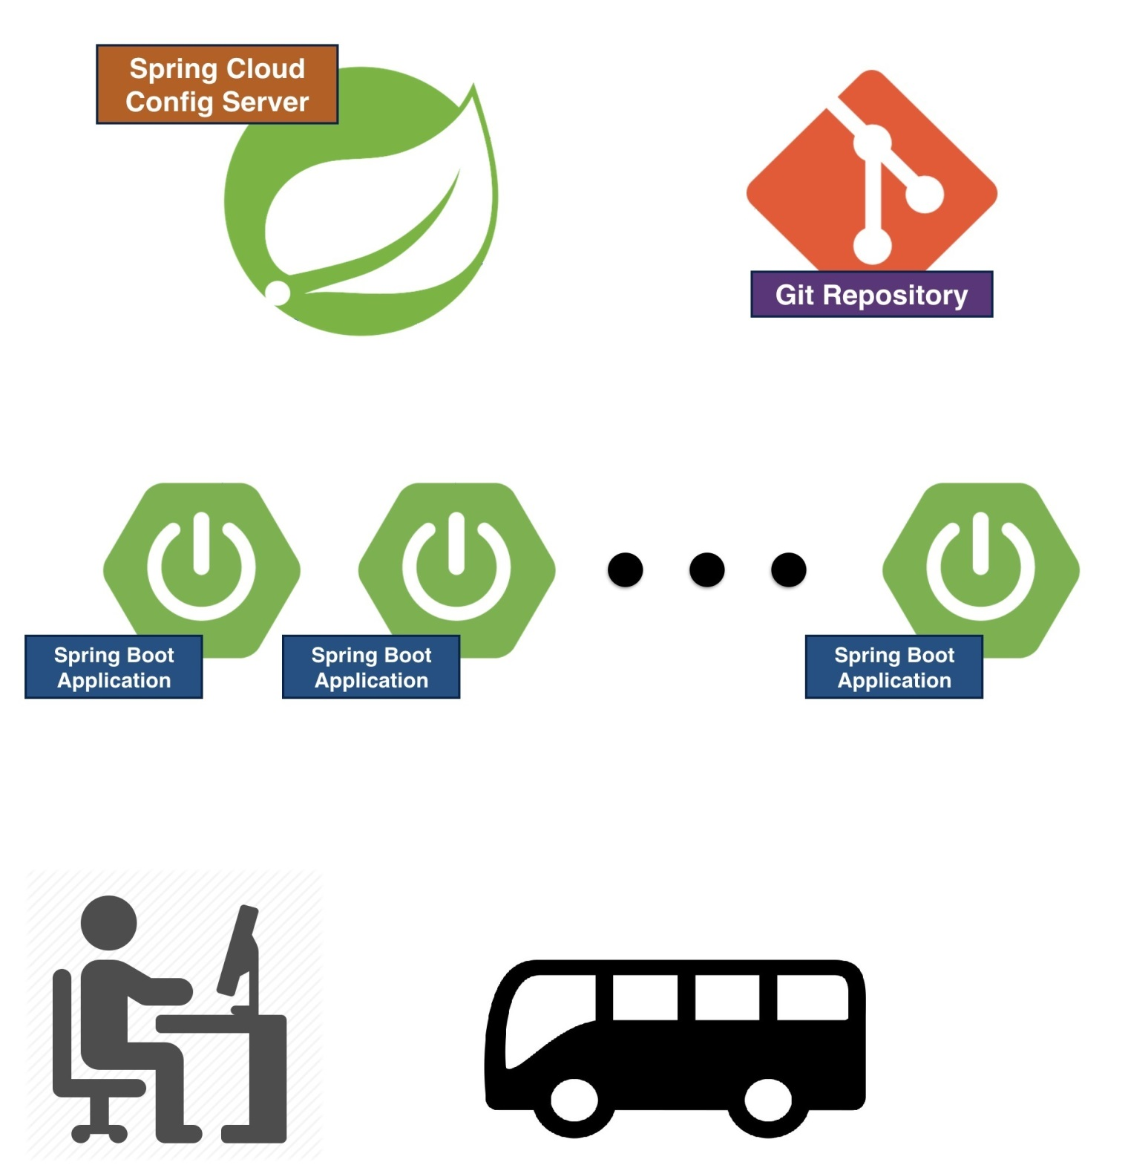
Spring Cloud BUS
BUS/Refresh
Refresh
Refresh
Cloud Bus

Slide 15
What if Config Server is down?
Spring Cloud Config Server should typically run on several instances
So down time should be a non-issue

Slide 16
REFERENCES
https://cloud.spring.io/spring-cloud-static/Edgware.SR4/single/spring-cloud.html
https://spring.io/guides/gs/centralized-configuration/
https://dzone.com/articles/microservices-and-spring-cloud-config-server

Slide 17

Thank You

